Slide 1

NCEA Year 11 the beginning of the Journey to gain qualifications

Slide 2
Karakia Tīmatanga
Tūtawa mai i runga
Tūtawa mai i raro
Tūtawa mai i roto
Tūtawa mai i waho
Kia tau ai te mauri tū,
te mauri ora ki te katoa
Haumi e, hui e
Tāiki e!
Come forth from above
Come forth from below
Come forth from within
Come forth from the environment
Vitality and wellbeing for all
Strengthened in unity

Slide 3
Kia ora welcome
Supports for you & your daughter at Year 11.....
YEAR 11 YLC'S Lucy Richardson & Courtney Hansen
AT Teachers
Subject Teachers / HOF'S
Guidance - Connexions

Slide 4
Support for whanau & students
School TV
SchoolTV - is a wellbeing platform on the school website. It has resources for students, teachers, and parents on a range of mental health and wellbeing topics.
You can access SchoolTV on the school website under:
Student Life > Student Wellbeing > SchoolTV
Here is a direct link: https://southlandgirls.nz.schooltv.me/
Stymie
Stymie is an anonymous reporting tool for students to report any form of harm to themselves, others or the community.
Students can access Stymie on the school website under:
Student Life > Student Wellbeing > Stymie
Here is a direct link: https://about.stymie.co.nz/

Slide 5
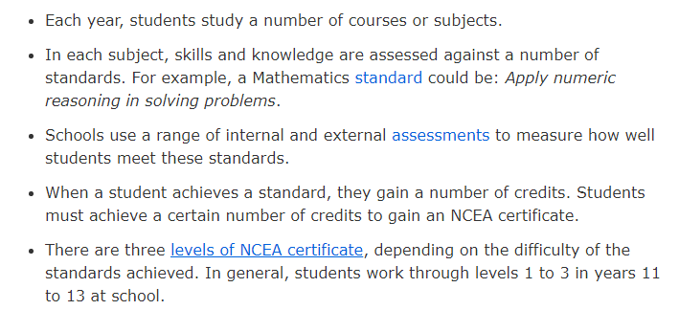
Ncea overview

Slide 6
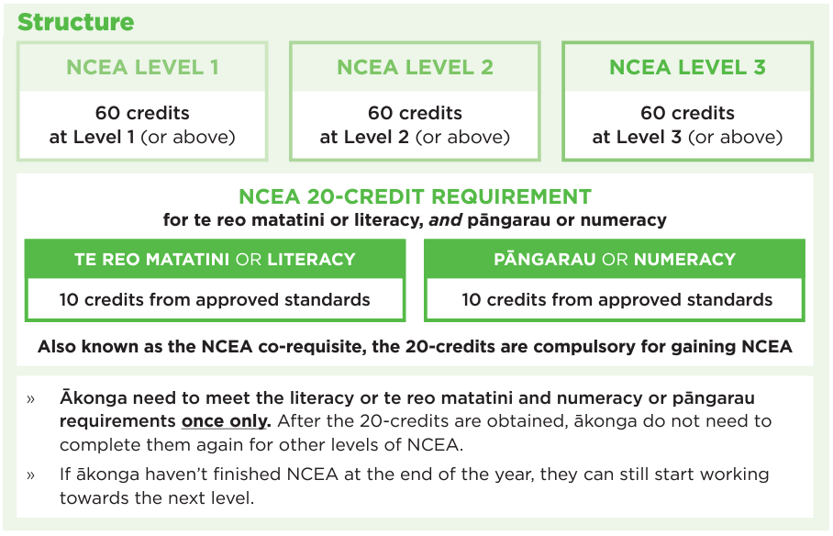

Slide 7
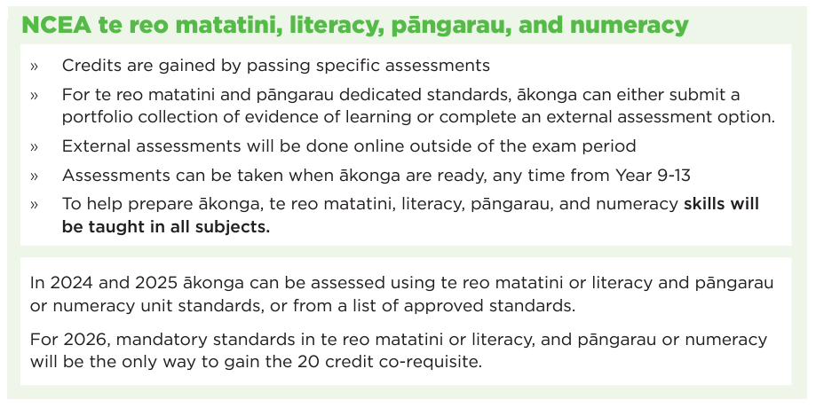

Slide 8

Key NCEA Jargon
Subject Endorsements
Course Endorsements
Resubmission
Reassessment
N, A, M, E
University Entrance (UE)
Special Assessment Conditions (SAC)
Internal Assessment
External Assessment (Examination vs Portfolio)

Slide 9
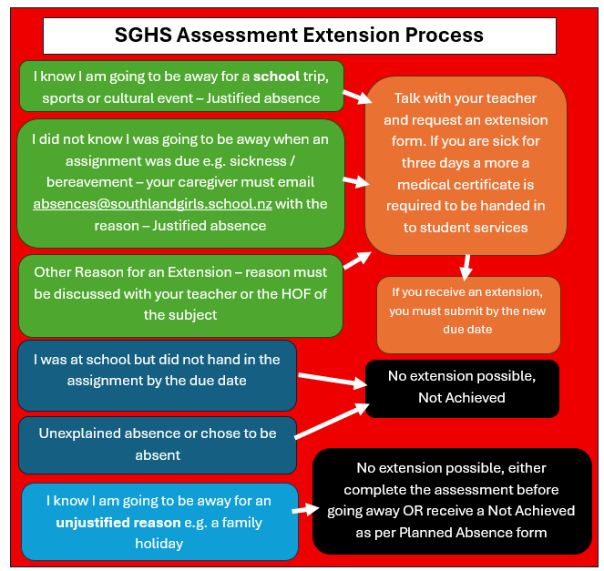
SGHS Processes and Procedures - Extensions

Slide 10
SGHS Processes and Procedures - Authenticity
Students must be able to demonstrate that the assessed work is their own.
Where the student, upon questioning, cannot demonstrate they understand the work they have handed in they will receive a Not Achieved.
Usually, students do not understand the work they have handed in due to overuse of other students work, AI or plagiarism.

Slide 11
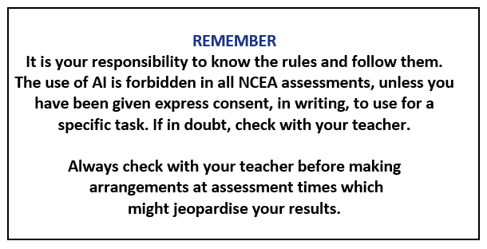

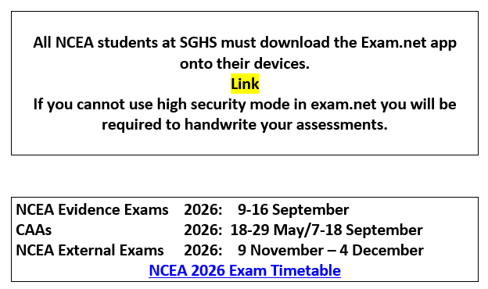

Slide 12
Where to find information
https://ncea.education.govt.nz/supporting-akonga-and-whanau
https://www.southlandgirls.school.nz/nzqa/

Slide 13
SLEEP
Sleep is vitally important for a teenage body and brain.
It supports learning, memory consolidation, growth and emotional processing.
Recommended 8-10 hours of sleep per night for a teenager.
Teenagers tend to release melatonin later than adults or children which makes falling asleep earlier than 10pm/11pm difficult for some.
Establish a night time routine and allowing enough "wind down" time in the evening will help.
No devices/blue light at least 30-60mins before bed.
Putting device on sleep mode or better still having them out of the bedroom all together.

Slide 14
Social Pressures
At Year 11 and onwards the pressures to attend party's, drink alcohol & socialise with friends becomes much more demanding.
As parents you can say NO!
Legal age for drinking in NZ is 18 and along with teen development the "NIKE BRAIN" is in full flight at this age.
It is important to support your teen with these decisions and making sure they are ok.

Slide 15

Managing myself
Diary
Outlook calendar
Assessment Dates are all mapped out
Year Planner on the fridge – map out from class year planners
Impact of absence including family holidays

Slide 16

Balance
Study / Sport /Cultural / Social / Work
We find busy students achieve well in school, but we need to make sure it doesn’t become overwhelming.
Notes:
Balancing school and sports – do they have time calved out for focusing on school
For just being a kid and having some down time.
Not letting work rule their time – need to know when to say no and will need your support in learning how to do this.

Slide 17

Building a profile
Over the next few years of schooling, your child will be building a profile to present themselves to future education institutions and/or future employers.
What will they have to add to their profile to show they're...
Reliable
Responsible
Committed
A good team member
Great communicator
Notes:
What have they participated in that can help bolster their CV?
Courses, work experience, cultural clubs, sports, volunteering etc. Huge range here at SGHS and lots of out of school options available.

Slide 18



Future planning – Tertiary Study Rese College Costs
Notes:
Heads up about starting to save for accommodation costs.
Otago estimated 2026 costs $20,000 - $25,000
Canterbury – ranges from $14,000 - $31,000
Waikato - $18,000 - $20,000
Upfront, 4 payments or 1 upfront payment and 38 weekly payments.

Slide 19
Karakia Whakamutunga
Kia whakairia te tapu
Kia wātea ai te ara
Kia turuki whakataha ai
Kia turuki whakataha ai
Haumi e, hui e
Tāiki e!
Restrictions are moved aside
So the pathway is clear
To return to everyday activities
Enriched, unified and blessed

